Slide 1
Review Session
Vijayalakshmi Anand
Notes:
<number>

Slide 2
Association Rule Analysis

Slide 3
What is association analysis
Association analysis measures the strength of co-occurrence between one item and another.

Slide 4
Definition: Association Rule
Association Rule
An implication expression of the form X → Y, where X and Y are itemsets
Example: {Milk, Diaper} → {Butter}
Rule Evaluation Metrics
Support (s)
Fraction of transactions that contain both X and Y
Confidence (c)
Measures how often items in Y appear in transactions that contain X
TID | Items
1 | Bread, Milk
2 | Bread, Diaper, Butter, Beans
3 | Milk, Diaper, Butter, Coke
4 | Bread, Milk, Diaper, Butter
5 | Bread, Milk, Diaper, Coke
Example:

Slide 5
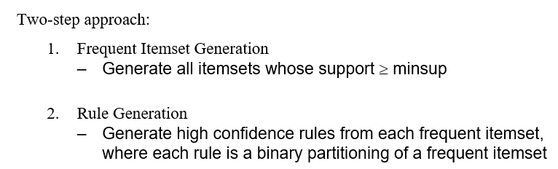
Mining association rules
There are two approaches for Frequent item set generation
1.Apriori principle
2.FB growth algorithm

Slide 6
Steps in Apriori algorithm
join and the prune steps iteratively until the most frequent item set is achieved
Steps:
1.First step is to find 1-itemsets candidate.
2. Find the support of all item sets . Then ,Only those candidates which count more than or equal to min_sup, are taken ahead for the next iteration and the others are pruned.
3.Find 2-itemset frequent items with min_sup (combine items with all other items-Joinstep)
4.The 2-itemset candidates are pruned using min-sup threshold value. Now the table will have 2 –itemsets with min-sup only.
5.Find 3 –itemsets using join and prune step. This iteration will follow antimonotone property where the subsets of 3-itemsets, that is the 2 –itemset subsets of each group fall in min_sup. If all 2-itemset subsets are frequent then the superset will be frequent otherwise it is pruned.
6. Find 4-itemset by joining 3-itemset with itself and pruning if its subset does not meet the min_sup criteria. The algorithm is stopped when the most frequent itemset is achieved.

Slide 7
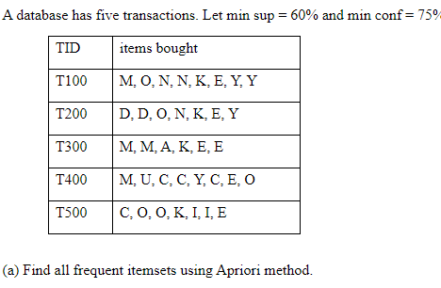
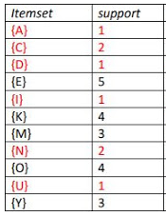
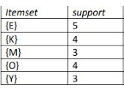
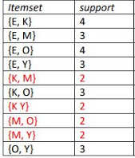
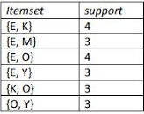

Apriori algortihm
Minsupport=60/100*5=3/5*5=3
1itemset –after removing items which has less than min threshold.
1-itemset
2itemsets
2itemset –after removing items which has less than 3
3-itemset

Slide 8
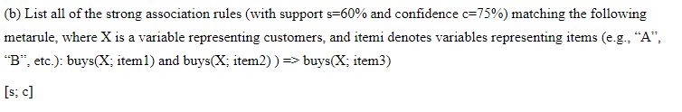
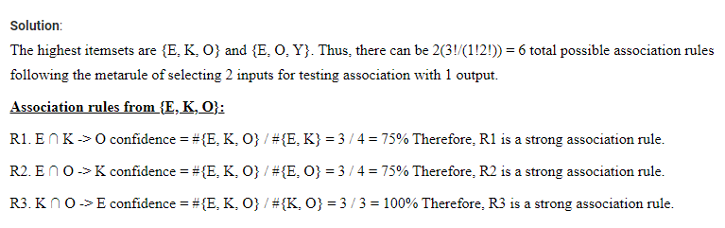
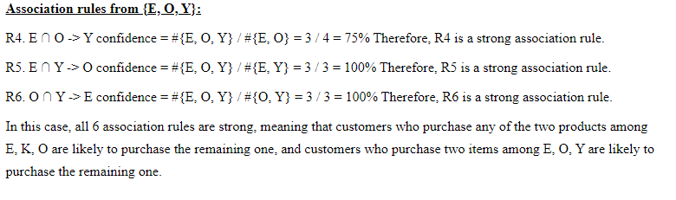

Slide 9
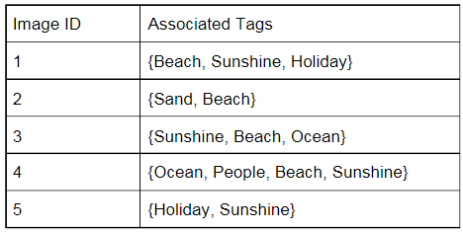
Practice problem
Images and their associated tags are shown in the table given below. Apply Apriori algorithm to discover strong association rules. Assume that min_support=40% and min_confidence=70%.
a. Generate candidate itemsets and qualified frequent itemsets step by step until the largest frequent itemset is generated. [6 marks]
b. Generate association rules from the frequent itemsets. Calculate the confidence of each rule and identify all the strong association rules. [6 marks]

Slide 10
FB growth algorithm
FP growth algorithm used for finding frequent itemset in a transaction database without candidate generation.

Slide 11
Steps
Scan DB once, find frequent 1-itemset (Remove the items which has less than min support)
Create ordered item set.[Iterating the Frequent Pattern set and checking if the current item is contained in the transaction]
Construct the FB tree
Construct the conditional FP tree in the sequence of reverse order of F - List - generate frequent item set

Slide 12
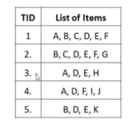
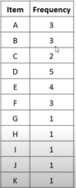
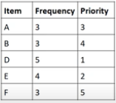
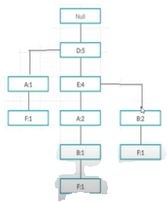
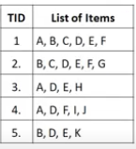
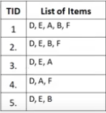
Step2)Sort
Step5)Conditional pattern base
Minsup=3
Step1)1-itemset
item | Conditional pattern base
F | {D,A:1}{D,E,A,B:1}{D,E,B:1}
B | {D,E,A:1},{D,E:2}
A | {D:1},{D,E:2}
E | {D:4}
D
Step4)FP tree
Step3)Order the items according to priority
Step6:Frequent pattern
item |  | Frequent pattern base
F | {D:1} | {FD:1}
B | (D,E:3) | {BD:3),{BE:3}{BDE:3}
A | {D:3} | {AD:3}
E | {D:4} | {ED:4}
D

Slide 13
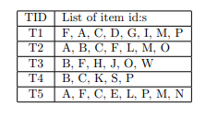
Problems for practice
Construct the FP tree and find frequent item set for the given transaction

Slide 14
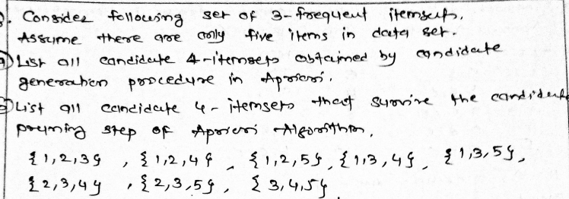
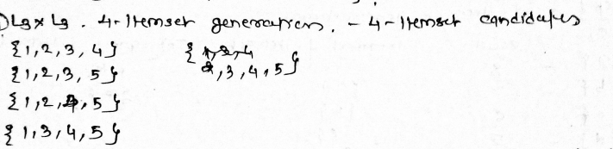
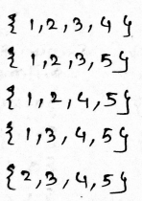
Only 1245 is a 4 item set after pruning

Slide 15
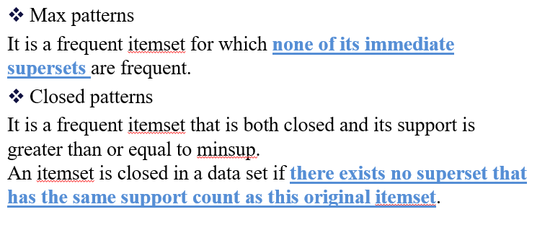
Max patterns and closed patterns

Slide 16
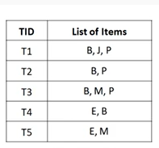
Practice problem
Find frequent , closed and maximum itemset
Minimum support count =40%

Slide 17
Computing Interestingness Measure
Given a rule X → Y, information needed to compute rule interestingness can be obtained from a contingency table
Contingency table for X → Y
 | Y | Y
X | f₁₁ | f₁₀ | f₁₊
X | f₀₁ | f₀₀ | f_{o+}
 | f₊₁ | f₊₀ | |T|
f₁₁: support of X and Y f₁₀: support of X and Y f₀₁: support of X and Y f₀₀: support of X and Y
Used to define various measures
support, confidence, lift, Gini, J-measure, etc.

Slide 18
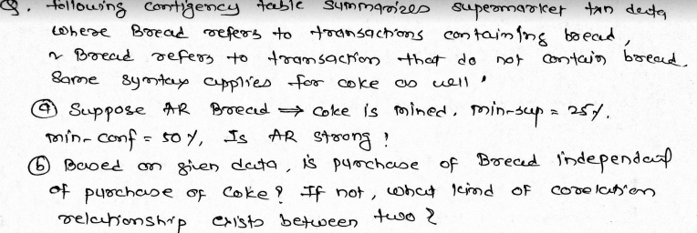
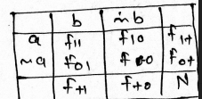
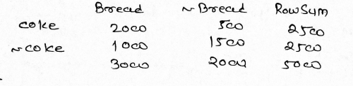
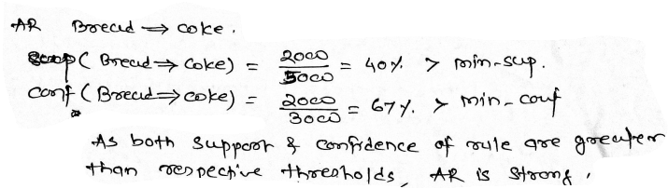

Slide 19
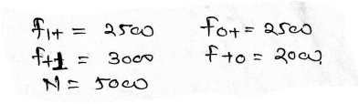
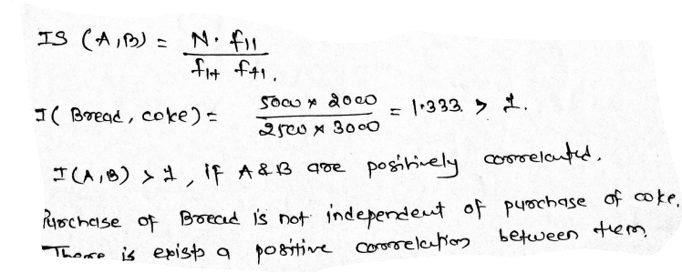

Slide 20
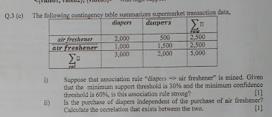
Practice problem

Slide 21
Clustering

Slide 22
What is cluster analysis
Finding groups of objects such that the objects in a group will be similar (or related) to one another and different from (or unrelated to) the objects in other groups

Slide 23
Clustering methods
There are 3 methods of clustering
1.Partitional method
K means clustering algorithm
K mediod clustering algorithm
2.Hierachical clustering algorithm
Agglomerative clustering
Divisive clustering
3.Density based clustering
DBSCAN algorithm

Slide 24
K-Means clustering algorithm

Slide 25
Steps to implement K-means clustering algorithm
1.Assume number of clusters
2.Randomly select centroids
3.Claculate distance
4.Combine them based on the minimum distance
5.Till the same mean (one dimensional)
or
Till all the points are put it in clusters.(two dimensional)

Slide 26
Example1-Kmeans clustering for one dimensional data set
Using K-means clustering, cluster the following data into two clusters and show each step
{2, 4, 10, 12, 3, 20, 30, 11, 25}
Given: {2, 4, 10, 12, 3, 20, 30, 11, 25}
Step 1: Assign alternate value to each cluster randomly.
Step 2: k1= {2, 10, 3, 30, 25}, Mean value= 14
k2= {4, 12, 20, 11, 25}, Mean value = 11.75
Step 3: Again assign the values,
k1 = {20, 30, 25}, Mean value = 25
k2 = {2, 4, 10, 12, 3, 11}, Mean value = 7
Step 4: Again assign the values,
k1 = {20, 30, 25}, Mean value = 25
k2 = {2, 4, 10, 12, 3, 11}, Mean value = 7
Since the mean values are same in step 3 and step 4, k1 and k2 in step 3 and step4 are required clusters.

Slide 27
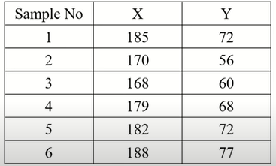
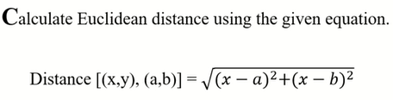
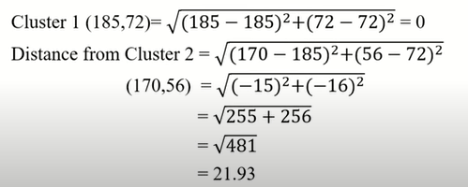
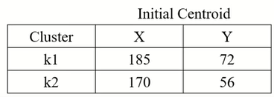
Example2:K-means Clustering two dimension
<number>

Slide 28
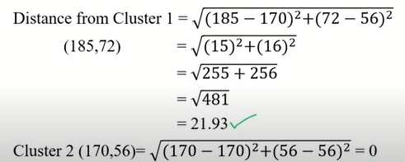
Contd..
<number>

Slide 29
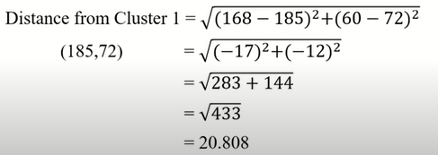
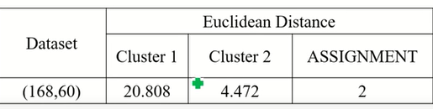
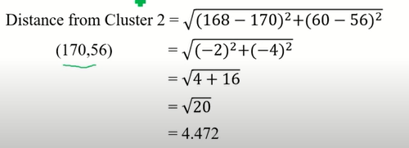
Contd..
<number>

Slide 30
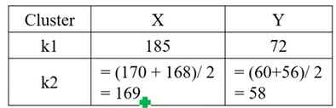
Contd..
Update the cluster centroid
<number>

Slide 31
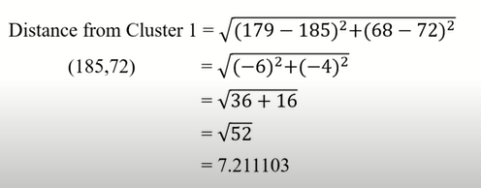
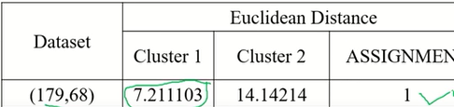
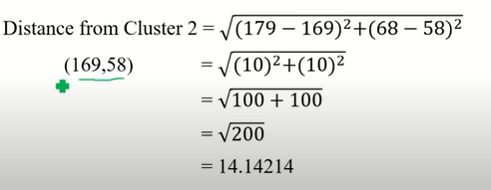
Contd..
<number>

Slide 32

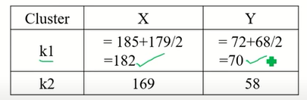
Contd..
<number>

Slide 33

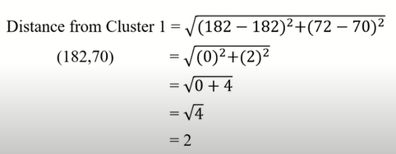
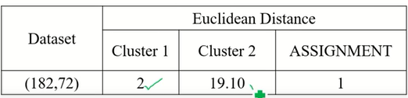
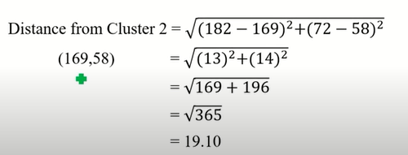
<number>

Slide 34
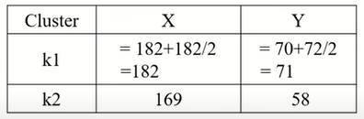
Update the cluster centroid
<number>

Slide 35
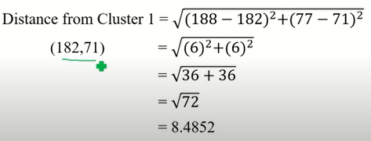
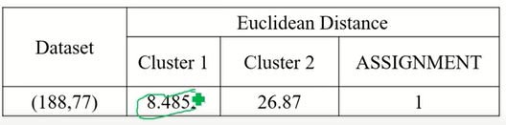
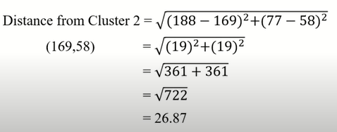
<number>

Slide 36
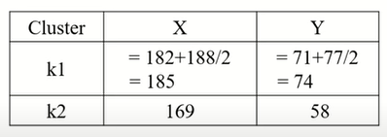
Update cluster centroid
<number>

Slide 37

Final assignment
<number>

Slide 38
Example3
You would like to cluster 7 observations into 3 clusters using k-means clustering algorithm. After first iterations clusters ,c1,c2,c3 has following observations
C1:{(2,2),(4,4),(6,6)}
C2:{(0,4),(4,0)}
C3:{(5,5),(9,9)} what will be the centroid clusters if you want to proceed for second iteration?

Slide 39

Practice problem1

Slide 40

Practice problem2
Using K-means clustering algorithm to create clusters

Slide 41
K-Medoid clustering algorithm
1. Initialize: select k random points out of the n data points as the medoids. 2. Associate each data point to the closest medoid by using any common distance metric methods. 3. While the cost decreases: For each medoid m, for each data o point which is not a medoid: 1. Swap m and o, associate each data point to the closest medoid, recompute the cost. 2. If the total cost is more than that in the previous step, undo the swap.

Slide 42



K medoid algorithm
Step 1: Randomly select 2 medoids as k = 2 .For example C1 -(4, 5) and C2 -(8, 5) are the two medoids.
Step 2: Calculating cost.
Step 3: randomly select one non-medoid point and recalculate the cost.
Each point is assigned to that cluster whose dissimilarity is less. So, the points 1, 2, 5 go to cluster C1 and 0, 3, 6, 7, 8 go to cluster C2. The New cost = (3 + 4 + 4) + (2 + 2 + 1 + 3 + 3) = 22 Swap Cost = New Cost – Previous Cost = 22 – 20 and 2 >0
The points 1, 2, 5 go to cluster C1 and 0, 3, 6, 7, 8 go to cluster C2. The Cost = (3 + 4 + 4) + (3 + 1 + 1 + 2 + 2) = 20

Slide 43
Hierarchical Clustering

Slide 44

What is Hierarchical clustering
Two methods:
Agglomerative:
Start with the points as individual clusters
At each step, merge the closest pair of clusters until only one cluster (or k clusters) left.
Divisive:
Start with one, all-inclusive cluster
At each step, split a cluster until each cluster contains a point (or there are k clusters)

Slide 45
Agglomerative Clustering Example
Item | E | A | C | B | D
E | 0 | 1 | 2 | 2 | 3
A | 1 | 0 | 2 | 5 | 3
C | 2 | 2 | 0 | 1 | 6
B | 2 | 5 | 1 | 0 | 3
D | 3 | 3 | 6 | 3 | 0
From this you can ignore upper triangular data is it will be identical
Item | E | A | C | B | D
E | 0
A | 1 | 0
C | 2 | 2 | 0
B | 2 | 5 | 1 | 0
D | 3 | 3 | 6 | 3 | 0
<number>

Slide 46
Agglomerative Clustering Example
Item | E | A | C | B | D
E | 0
A | 1 | 0
C | 2 | 2 | 0
B | 2 | 5 | 1 | 0
D | 3 | 3 | 6 | 3 | 0
Step1: Find out the smallest distance except 0, here it is 1 between E and A
So, dendrogram will be
1
E
A
Step2: Merge cell E and A, to find the distance between EA and C, We need to find
Min dist [ {E,A}, C] Min dist [ (E,C), (A,C)] Min dist [2,2] = 2
Likewise you need to find it for EA,B and EA,D
Item | EA | C | B | D
EA | 0
C | 2 | 0
B | 2 | 1 | 0
D | 3 | 6 | 3 | 0
<number>

Slide 47
Agglomerative Clustering Example
Item | EA | C | B | D
EA | 0
C | 2 | 0
B | 2 | 1 | 0
D | 3 | 6 | 3 | 0
Again Find out the smallest distance except 0, here it is 1 between B and C
So, dendrogram will be
1
E
A B
C
Merge cell B and C, to find the distance between EA and BC, We need to find
Min dist [ {E,A}, {B,C}]
Min dist [ (E,B), (E,C), (A,B), (A,C)]
Min dist [2,2,2,5] = 2
Likewise you need to find it for BC and D
Item | EA | BC | D
EA | 0
BC | 2 | 0
D | 3 | 3 | 0
<number>

Slide 48
Agglomerative Clustering Example
Item | EA | BC | D
EA | 0
BC | 2 | 0
D | 3 | 3 | 0
Again Find out the smallest distance except 0, here it is 2 between EA, and BC
So, dendrogram will be
2
1
E
A B
C
Merge cell EA and BC, to find the distance between EABC and D, We need to find
Min dist [ {E,A,B,C}, {D}]
Min dist [ (E,D), (A,D), (B,D), (C,D)]
Min dist [3,3,6,3] = 3
Item | EABC | D
EABC | 0
D | 3 | 0
<number>

Slide 49
Agglomerative Clustering Example
Item | EABC | D
EABC | 0
D | 3 | 0
Again smallest distance is 3
So, dendrogram will be
3
2
1
E
AB
C
D
Merge cell EABC and D
Item | EABCD
EABCD | 0
<number>

Slide 50


Practice problem1
Find the cluster using Hierarchical approach for the six points shown in the figure and draw dentogram. Use Euclidean distance for finding nearest point.

Slide 51
Agglomerative algortihms
Single Link
Complete Link
Average Link

Slide 52

Single ,complete,average link
Single link Complete link
Average link
Dist(3,6),4= Max(3,4),(6,4)
Dist(3,6),4= Min(3,4),(6,4)
Dist(3,6),4= Avg(3,4),(6,4)

Slide 53
Divisive hierarchical clustering

Slide 54




Edge | cost
B-A | 1
C-B | 2
D-C | 3
E-C | 4
Edge | cost
B-A | 1
C-B | 2
D-C | 3
C-A | 4
E-C | 4
E-D | 4
E-A | 7
E-B | 8
1
A
1
A
B
B
D
2
C
4
2
E
E
C
3
3
D
D
E
3
D

Slide 55


Practice problem

Slide 56





Slide 57

K=3

Slide 58


Density based clustering
Clustering based on density (local cluster criterion), such as density-connected points

Slide 59

Example1

Slide 60
Outliers

Slide 61
What are outliers
Outlier: A data object that deviates significantly from the normal objects as if it were generated by a different mechanism
Collective outlier
Point outlier
Contectual outlier

Slide 62
Two methods
1.Statstical approach
Parametric - μ+-3σ
Non parametric –Histogram
2.Proximity based outliers
Distance based – kNearest neighbour
Density based-DBSCAN

Slide 63
Distance based outlier method K nearest neighbour method
Consider the data matrix given below .Assume that outlier score of object is given by average of distances to the first k nearest neighbours .Determine the outlier for the given dataset with 2 nearest neighbour approach
K=2
OS(P)=dist(p,x1)+dist(p,x2)………+dist(p,xn)/k
OS(A)=1+4/2=5/2=2.5
OS(B)=1+2/2=1.5
OS(C)=2+3/2=2.5
OS(D)=3+4/2=3.5
OS(E)=4+4/2=4
Outlier is E
 | A | B | C | D | E
A | 0 | 1 | 4 | 5 | 7
B | 1 | 0 | 2 | 6 | 8
C | 4 | 2 | 0 | 3 | 4
D | 5 | 6 | 3 | 0 | 4
E | 7 | 8 | 4 | 4 | 0

Slide 64
Local Reachability Density
Reachability distance from o’ to o:
where k is a user-specified parameter
that controls the smoothing effect
Local reachability density of o:
<number>

Slide 65

Local Outlier Factor: LOF
LOF (Local outlier factor) of an object o is the average of the ratio of local reachability of o and those of o’s k-nearest neighbors
The lower the local reachability density of o, and the higher the local reachability density of the k-NN of o, the higher LOF
This captures a local outlier whose local density is relatively low comparing to the local densities of its k-NN
<number>

Slide 66
Example
Consider the following 4 data points: a(0, 0), b(0, 1), c(1, 1), d(3, 0) Calculate the LOF for each point and show the top 1 outlier, set k = 2 and use Manhattan Distance.
Step 1: calculate all the distances between each two data points
• There are 4 data points: a(0, 0), b(0, 1), c(1, 1), d(3, 0) (Manhattan Distance here)
dist(a, b) = 1
dist(a, c) = 2
dist(a, d) = 3
dist(b, c) = 1
dist(b, d) = 3+1=4
dist(c, d) = 2+1=3

Slide 67
Step 2: calculate all the dist2 (o)
• distk (o): distance between o and its k-th NN( k-th nearest neighbour)
dist2 (a) = dist(a, c) = 2 (c is the 2nd nearest neighbor)
dist2 (b) = dist(b, a) = 1 (a/c is the 2nd nearest neighbor)
dist2 (c) = dist(c, a) = 2 (a is the 2nd nearest neighbor)
dist2 (d) = dist(d, a) = 3 (a/c is the 2nd nearest neighbor)

Slide 68
Step 3: calculate all the Nk (o)
■ k-distance neighbourhood of o, Nk
(o) = {o’| o’ in D, dist(o, o’) ≤ distk (o)}
N2 (a) = {b, c}
N2 (b) = {a, c}
N2 (c) = {b, a}
N2 (d) = {a, c}

Slide 69


Step 4: calculate all the lrdk (o)
lrdk (o): Local Reachability Density of o || Nk (o) || means the number of objects in Nk (o),
For example: || N2 (a) || = || {b, c} || = 2

Slide 70

Step 4: calculate all the lrdk (o)
reachdist2 (b ← a) = max{dist2 (b), dist(b, a)} = max{1, 1} = 1
reachdist2 (c ← a) = max{dist2 (c), dist(c, a)} = max{2, 2} = 2
Thus, lrd2 (a) = || N2 (a) || / reachdist2 (b←a)+reachdist2 (c←a)=2/(1+2) = 0.667

Slide 71
kNearestSet(a) = { b, c }
kNearestSetCount(a) = 2
LOF(a) = [LRD(b) + LRD(c)] * [reachDist(b <- a) + reachDist(c <- a)] / kNearestSetCount(a)*kNearestSetCount(a)
LOF(a) = [.5 + .667] * [1 + 2] / (2 * 2)
LOF(a) = 3.501 / 4
LOF(a) = .87
LOF(b) = [LRD(a) + LRD(c)] * [reachDist(a <- b) + reachDist(c <- b)] / kNearestSetCount(b)*kNearestSetCount(b)
LOF(b) = 1.33
LOF(c) = [LRD(b) + LRD(a)] * [reachDist(a <- c) + reachDist(b <- c)] / kNearestSetCount(c)*kNearestSetCount(c)
LOF(c) = .87
LOF(d) =[LRD(a) + LRD(c)] * [reachDist(a <- d) + reachDist(c <- d)] / kNearestSetCount(d)*kNearestSetCount(d)
LOF(d) = 2

Slide 72
LOF(a) = .87
LOF(b) = 1.33
LOF(c) = .87
LOF(d) = 2
top 2 outliers from set are b and d.

Slide 73


Example1
Answer:
A conditional outlier, in this case, is that student whose BMI falls outside the range 18-30.
The conditional outliers are Stud 4, Stud 5, Stud 8, Stud 9 and Stud 10. Stud 10 was a point
outlier. So, there are conditional outliers other than point outliers.

Slide 74
Example2
Find out the outlier of the given data Using Box plot
6 47 49 15 42 41 7 39 43 40 36 [3 marks]
Ans: Sorted data
6,7,15,36,39,40,41,42,43,47,49
Q1=15
Q2 =40
Q3=43
IQR: Q3-Q1=28
Extremely high value =43+1.5*28=85
Extremely low value =15-1.5*28=27
Value less than 27 greater than 85 outlier
The outlier are 6,7,15

Slide 75

Thank you ☺
Q&A
Suggestions / Feedback
<number>
BITS Pilani, Pilani Campus

